Slide 1

Machine learning in Engineering (IE7374) PROJECT TOPIC: Predicting term deposit subscription by classification
NORTHEASTERN UNIVERSITY
Boston, Massachusetts (Fall 2021)
Anish Kumar Musunuru
Karan Paresh
Rashmi Nambiar Pappinisseri Puthenveettil

Slide 2
Agenda
Introduction
Data description
Methods
EDA
Results
Conclusion

Slide 3

Introduction
Banks offer term deposits to its customers on a fixed interest rate over a fixed period of time. This amount is usually used by the banks to loan the amount to other customers.
The loan is given with a higher interest rate so that banks can make profit which is called net interest margin. If the term deposit is withdrawn before the fixed period, a penalty fee is to be paid to the bank.

Slide 4
Data Description
The dataset used in this project deals with direct marketing campaigns for term deposit of a Portuguese banking institution. The campaigns are done on phone calls. The dataset consists of 4521 records with 16 attributes.
The goal is to predict whether the product (the bank term deposit) would be subscribed to or not.

Slide 5
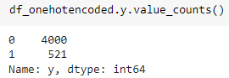
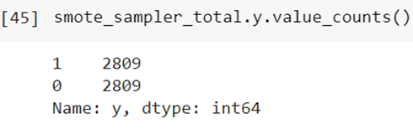
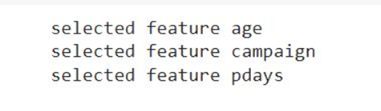
Methods
SMOTE sampling
Synthetic minority oversampling technique to balance dataset in terms of target variable
Feature selection by GridSearch
L2(ridge) penalty feature selection is found to perform the best
Elastic net - Uses both L1 and L2 penalties; performed to verify the results of L2 method, but gives only 3 features. This could lead to underfitting.

Slide 6
III. Machine learning
Logistic regression
Classifies datapoints using a sigmoid function. It converts the input to a value between 0 and 1
Parameters - learning rate, tolerance, maxIteration
Support vector machine
Classification algorithm which helps classify non-linear data by using kernel trick
Types of kernels - Radial basis function (RBF), linear
Parameters - kernels : rbf, linear, optimizer method: slsqp - Sequential Least SQuares Programming to minimize a function of several variables
Neural networks
Feed forward NN - information flows only on one direction
Parameters - activation function (sigmoid, relu), optimizer - adam

Slide 7
Exploratory Data Analysis

Slide 8
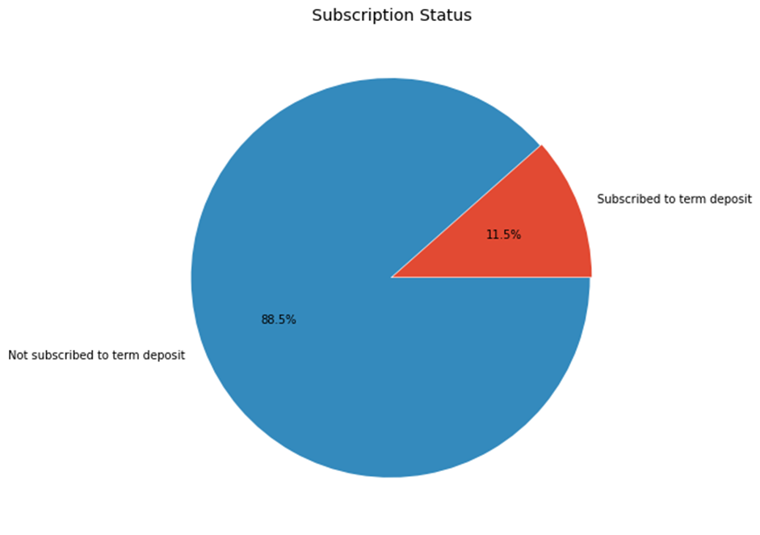
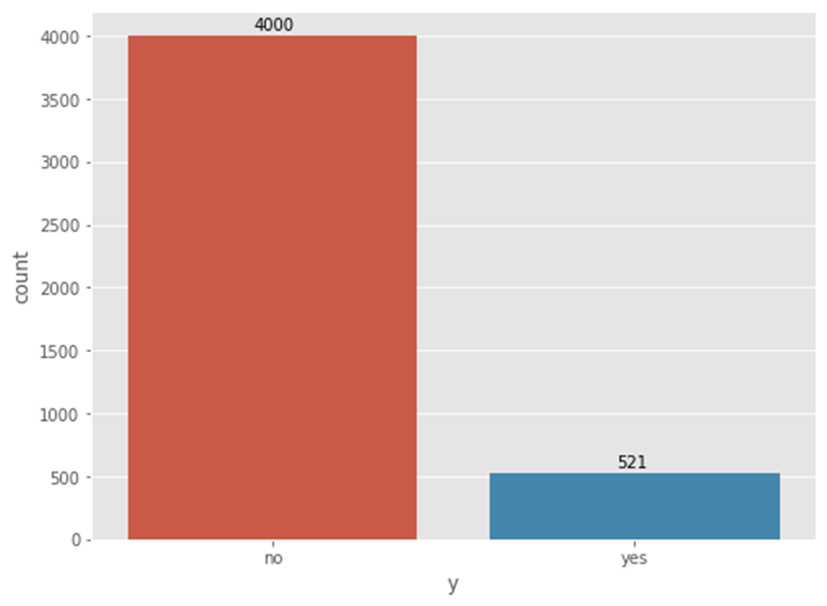
Subscription rate

Slide 9
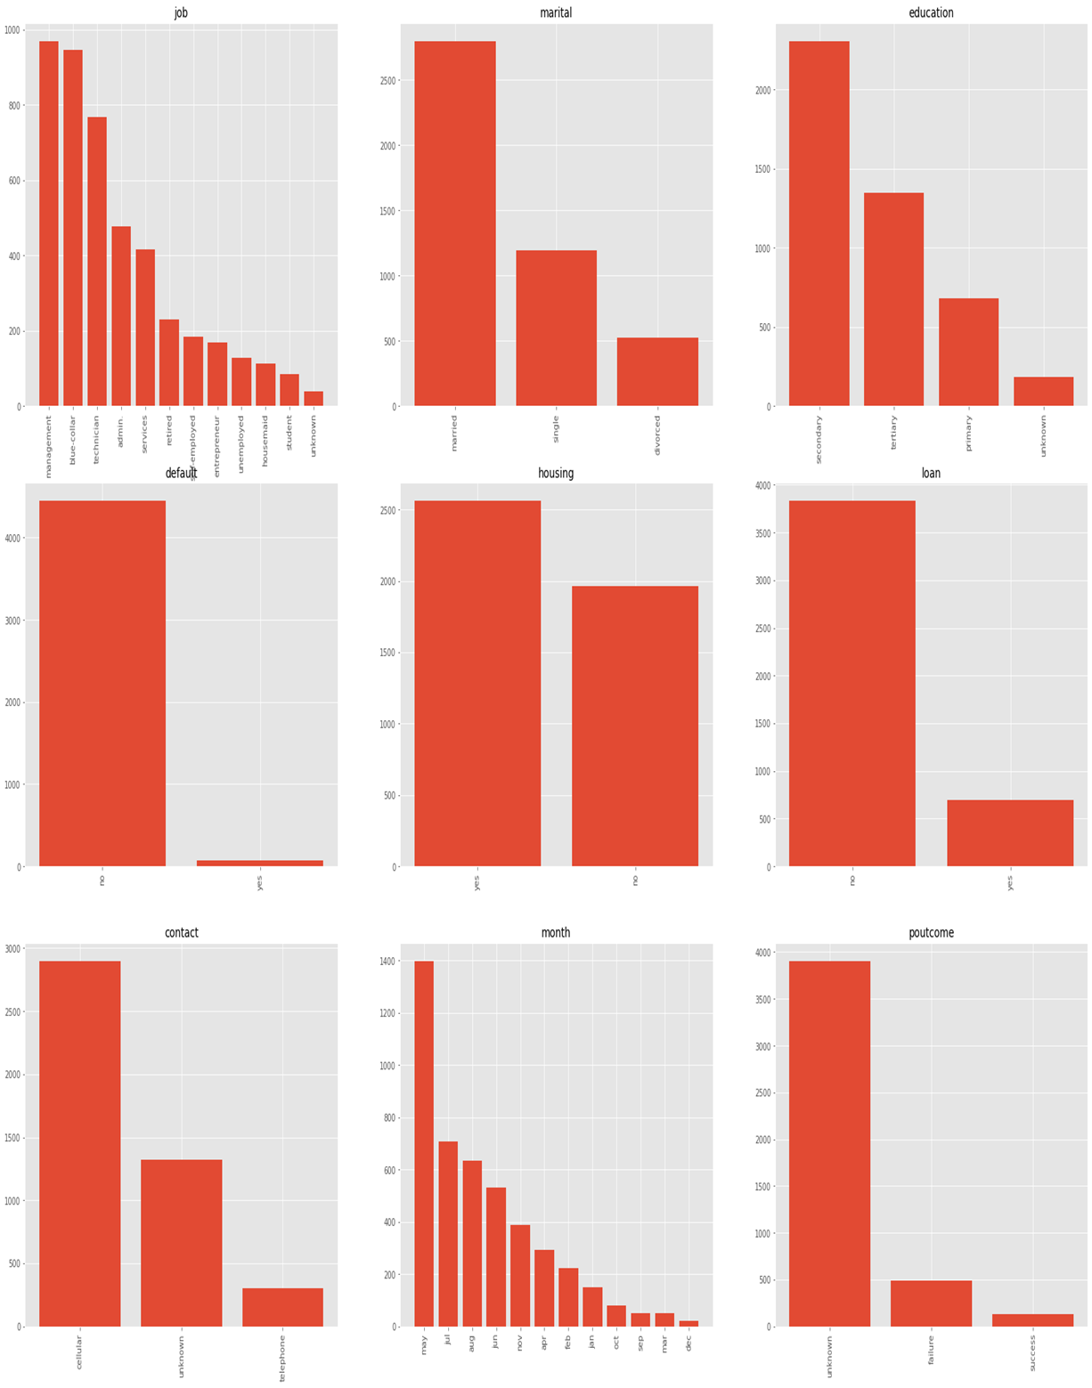

Slide 10
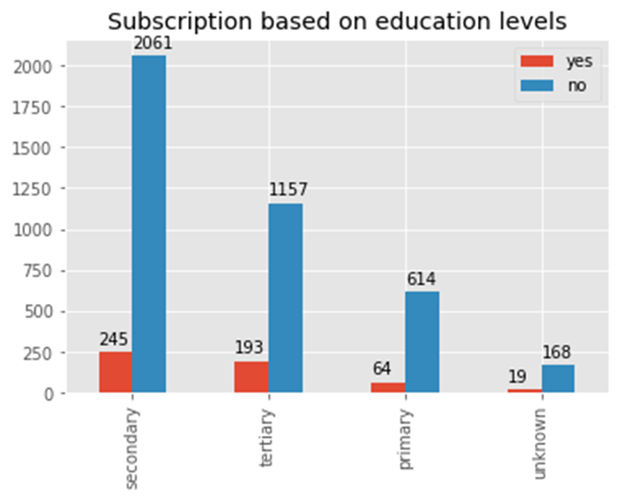
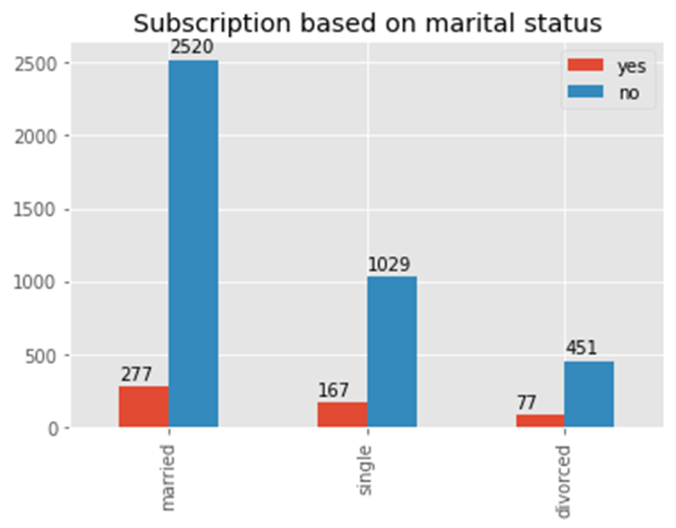

Slide 11
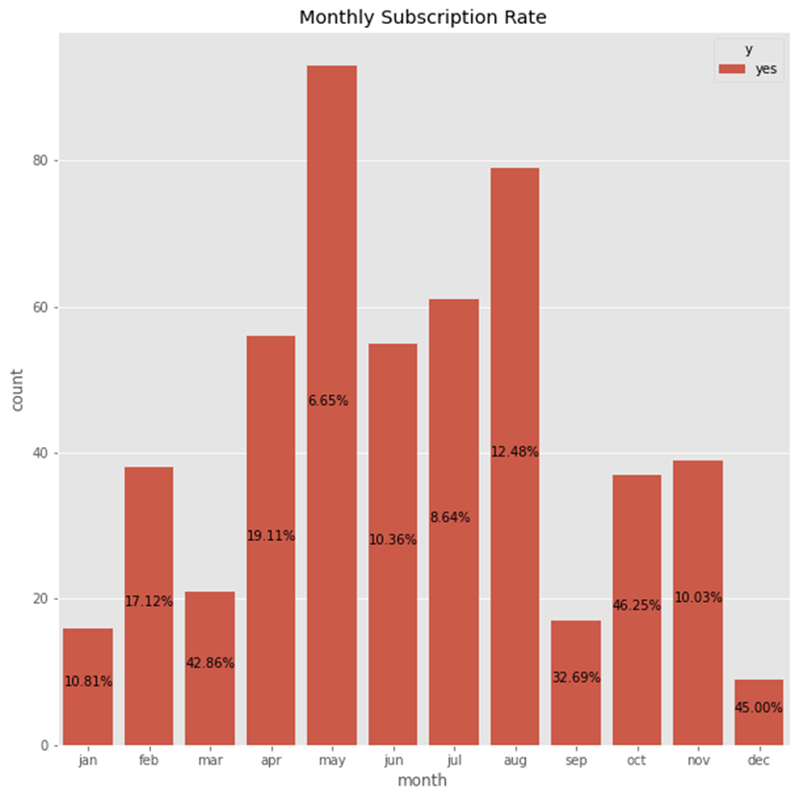
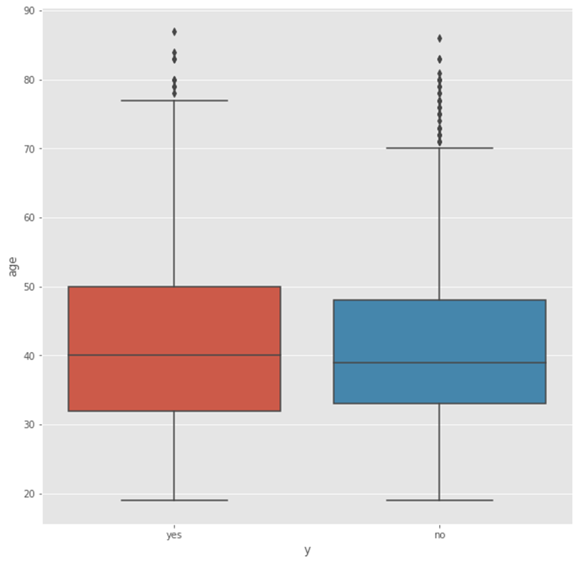
Boxplot of distribution of age vs subscription status

Slide 12
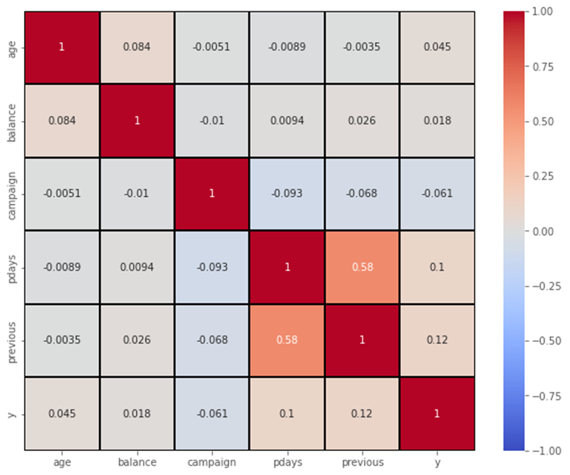
Correlation plot

Slide 13
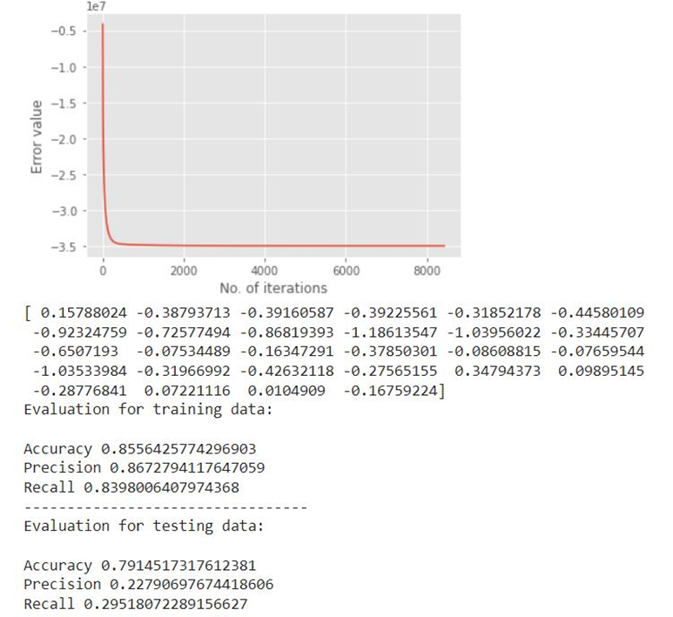
Results
Logistic Regression
(a) Learning rate = 0.0001
(b) tolerance = 0
(c) maxiteration = 10000

Slide 14
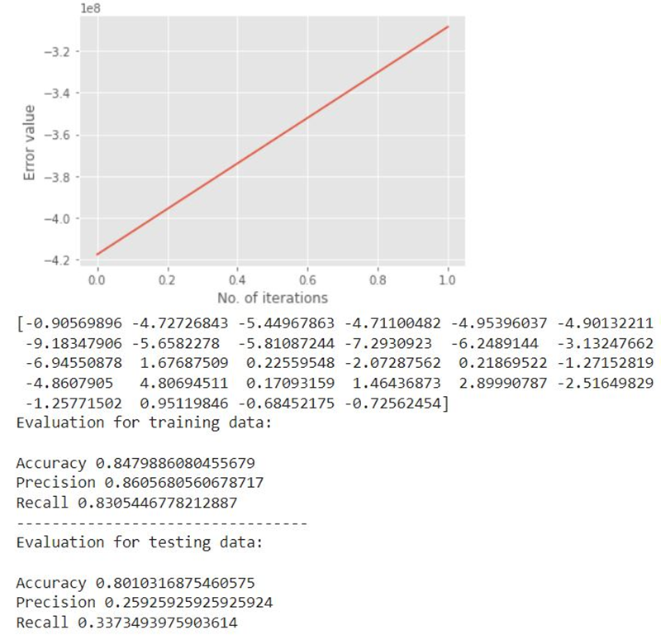
Logistic Regression
(a) Learning rate = 0.01
(b) tolerance = 0
(c) maxiteration = 10000

Slide 15
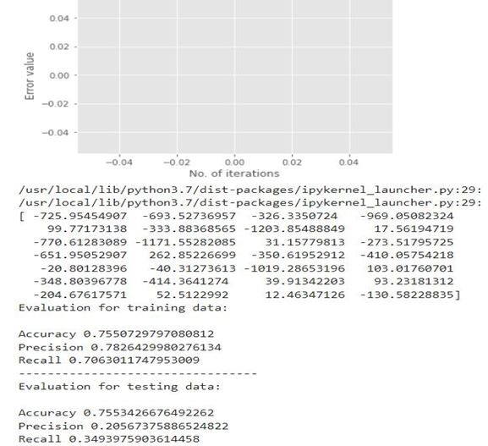
Logistic Regression
(a) Learning rate = 1
(b) tolerance = 0
(c) maxiteration = 10000

Slide 16
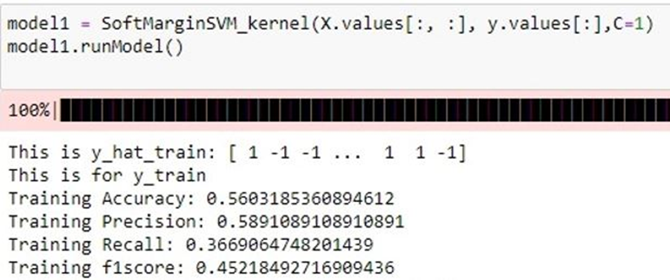
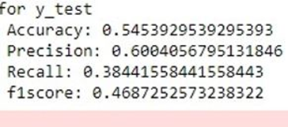
Support Vector Machine (SVM)
Radial Basis Function (RBF) Kernel

Slide 17
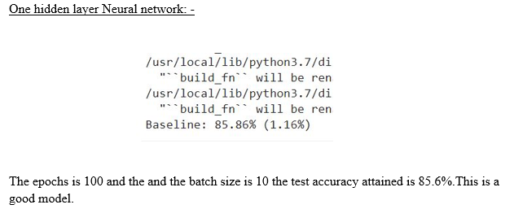
Neural Network

Slide 18
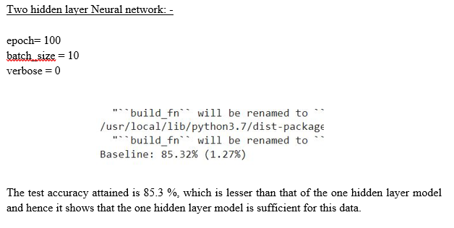
Neural Network

Slide 19
Conclusion
Throughout the course of the project, we incorporated techniques taught in class. For our baseline model, we used a logistic regression model. This model is a linear classifier. As the data we used was linearly separable, we saw that the baseline model performed well on the dataset.
The second classification Machine Learning model we implemented was SVM using RBF Kernel. As this model is a non-linear classifier, it performed worst as compared to the logistic regression model.
The final model we implemented is a feed-forward neural network using the Tensorflow and Keras packages. Through the implementation process, by playing around with the number of hidden layers, we found out that one hidden layer neural network model performs the best.

